Slide 1
Smart Campus Project
IoT Lab – BIT
S.Tamilselvan, AP/ECE

Slide 2
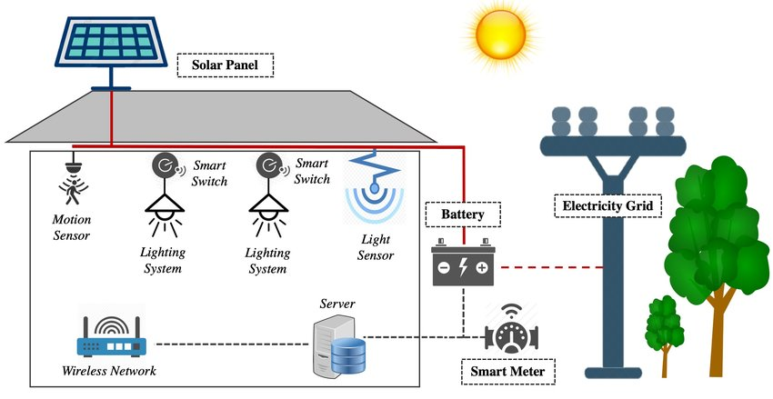
Smart Energy Management

Slide 3
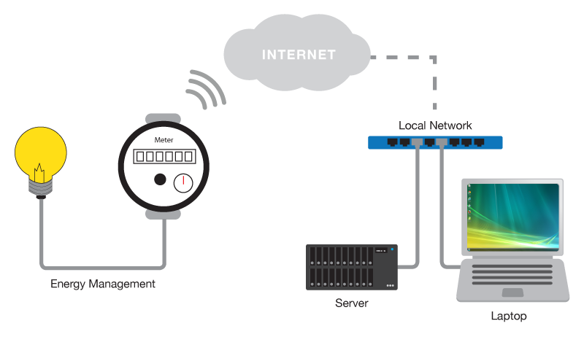
Smart Energy Management

Slide 4
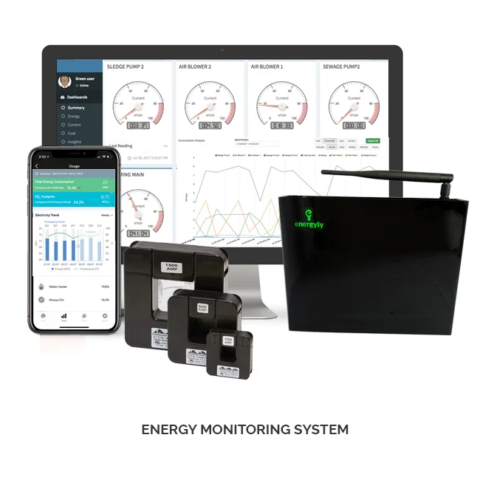
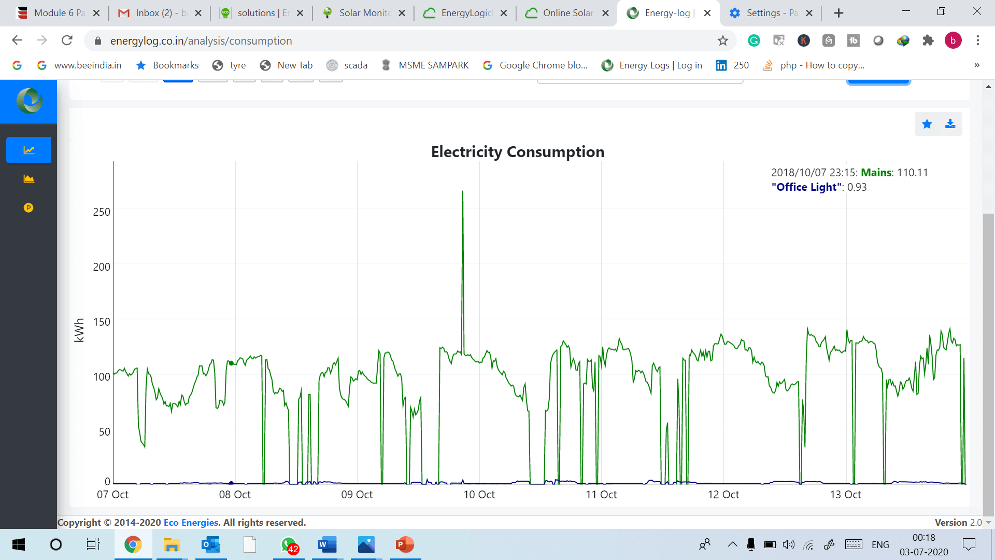
Smart Energy Management

Slide 5
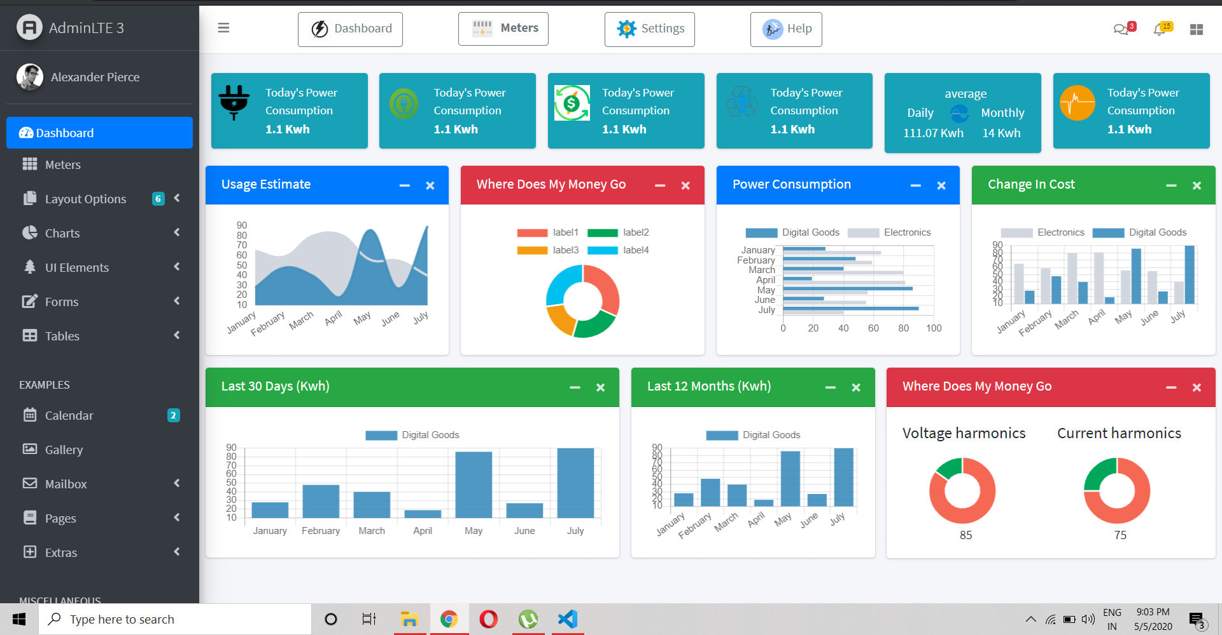
Smart Energy Management

Slide 6
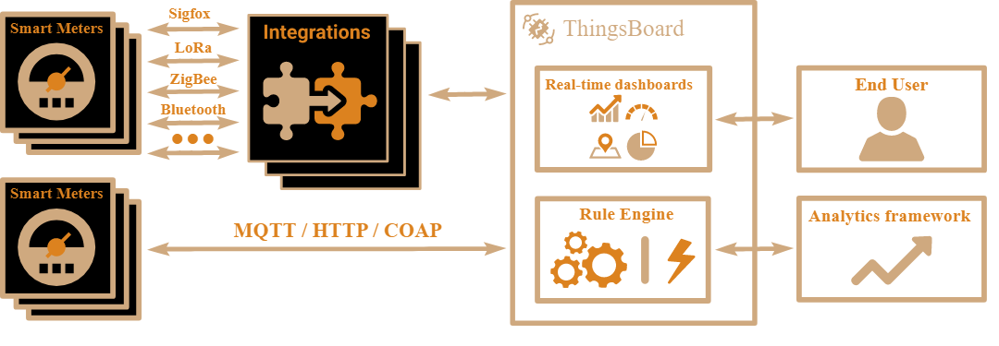
Smart Energy Management

Slide 7
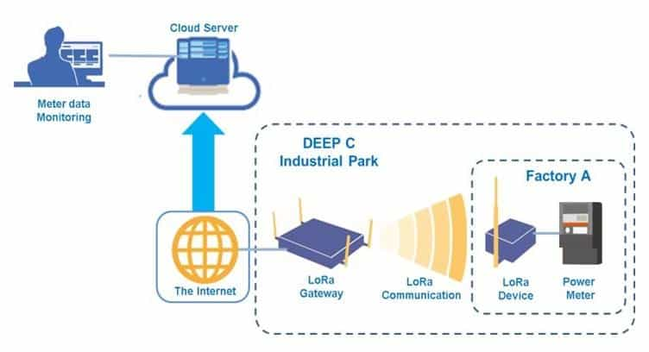
Smart Energy Management

Slide 8
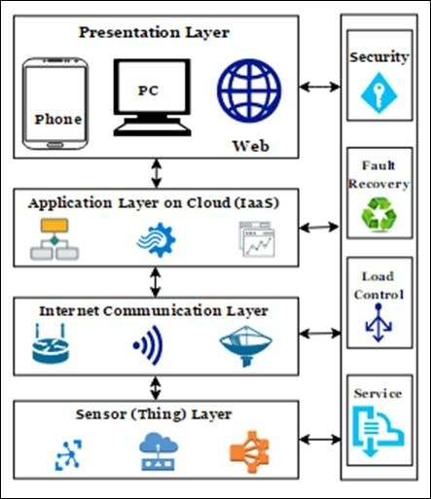
Smart Energy Management

Slide 9
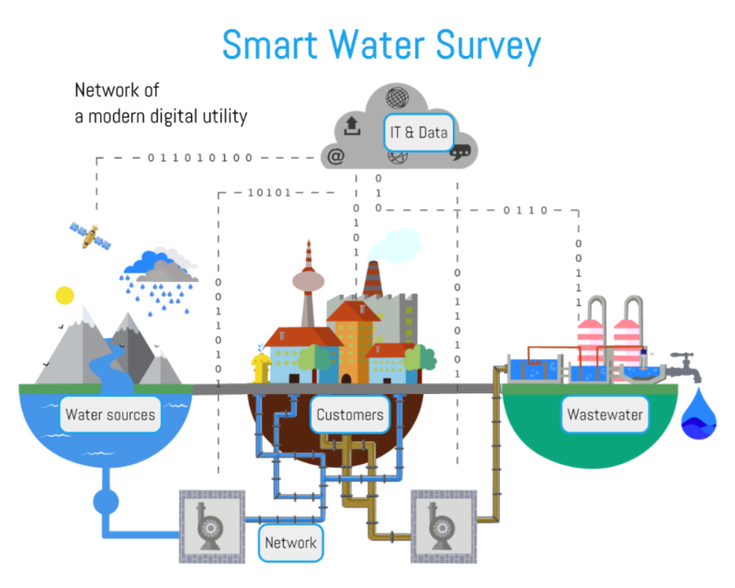
Smart Energy Management

Slide 10
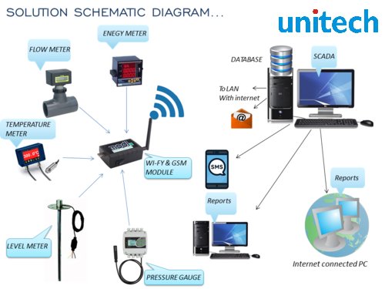

Slide 11
